Slide 1

Cyclistic Bike-Share: A Case Study By Benjamin Adu-Gyamfi

Slide 2
Outline
Introduction
What is the data saying?
Conclusion
Recommendations

Slide 3
Introduction
Statement of Business Task
Understanding how annual Members and Casual riders differ, why Casual riders would buy a membership, and how digital media could affect their marketing tactics.

Slide 4
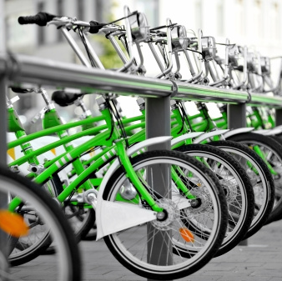
What is the data saying?

Slide 5
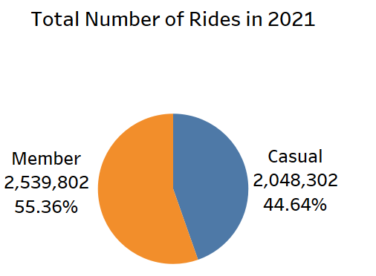
Total number of rides in 2021
Analyzed data span from January 2021 to December 2021.
The initial overview suggests that there are more rides taken by Members than Casual users.

Slide 6
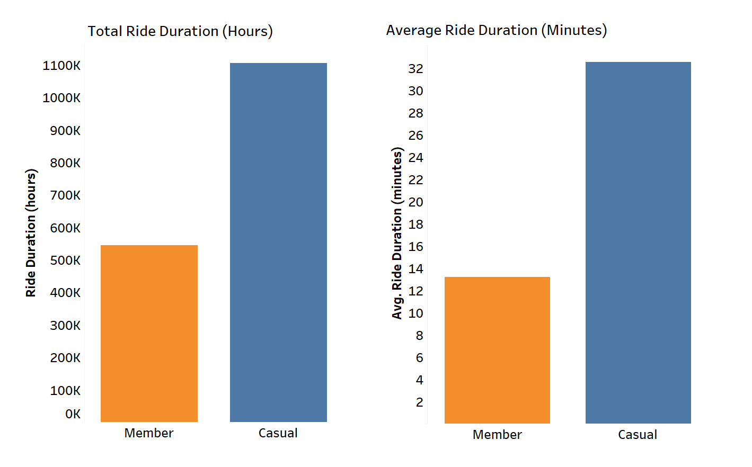
Ride duration
Casual users take longer trips than Members.
The ride duration for Casual users was ~ 2X more than that of Members.

Slide 7
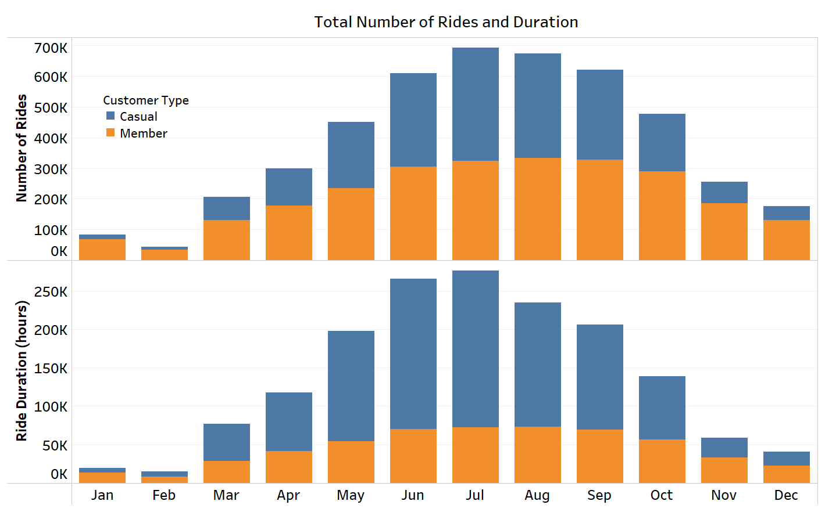
Yearly Snapshot
Months with colder temperatures correlate with low number of rides and shorter ride durations and vice versa.

Slide 8
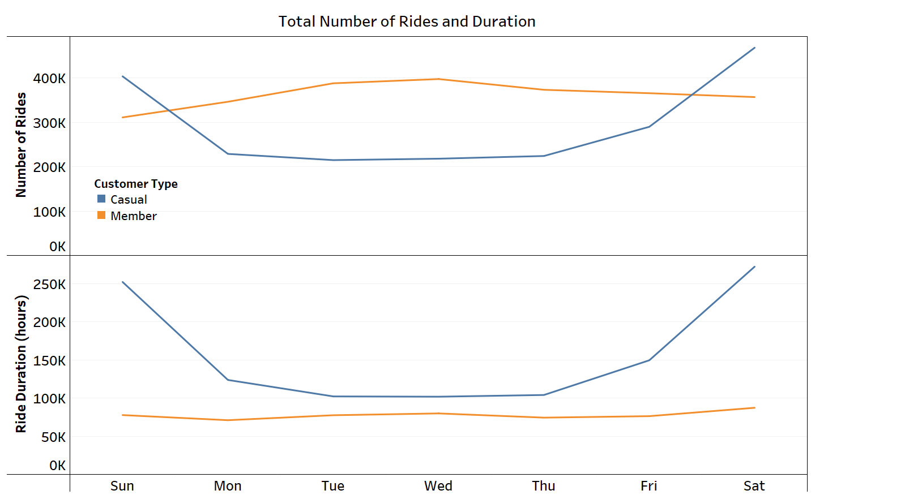
Weekly Snapshot
The number of rides by Members slightly increased by ~ 33% going into the weekdays. However, ride duration are almost the same throughout the week.
Contrary, Casual users have about 50% more number of rides and duration during the weekends than the weekdays.

Slide 9
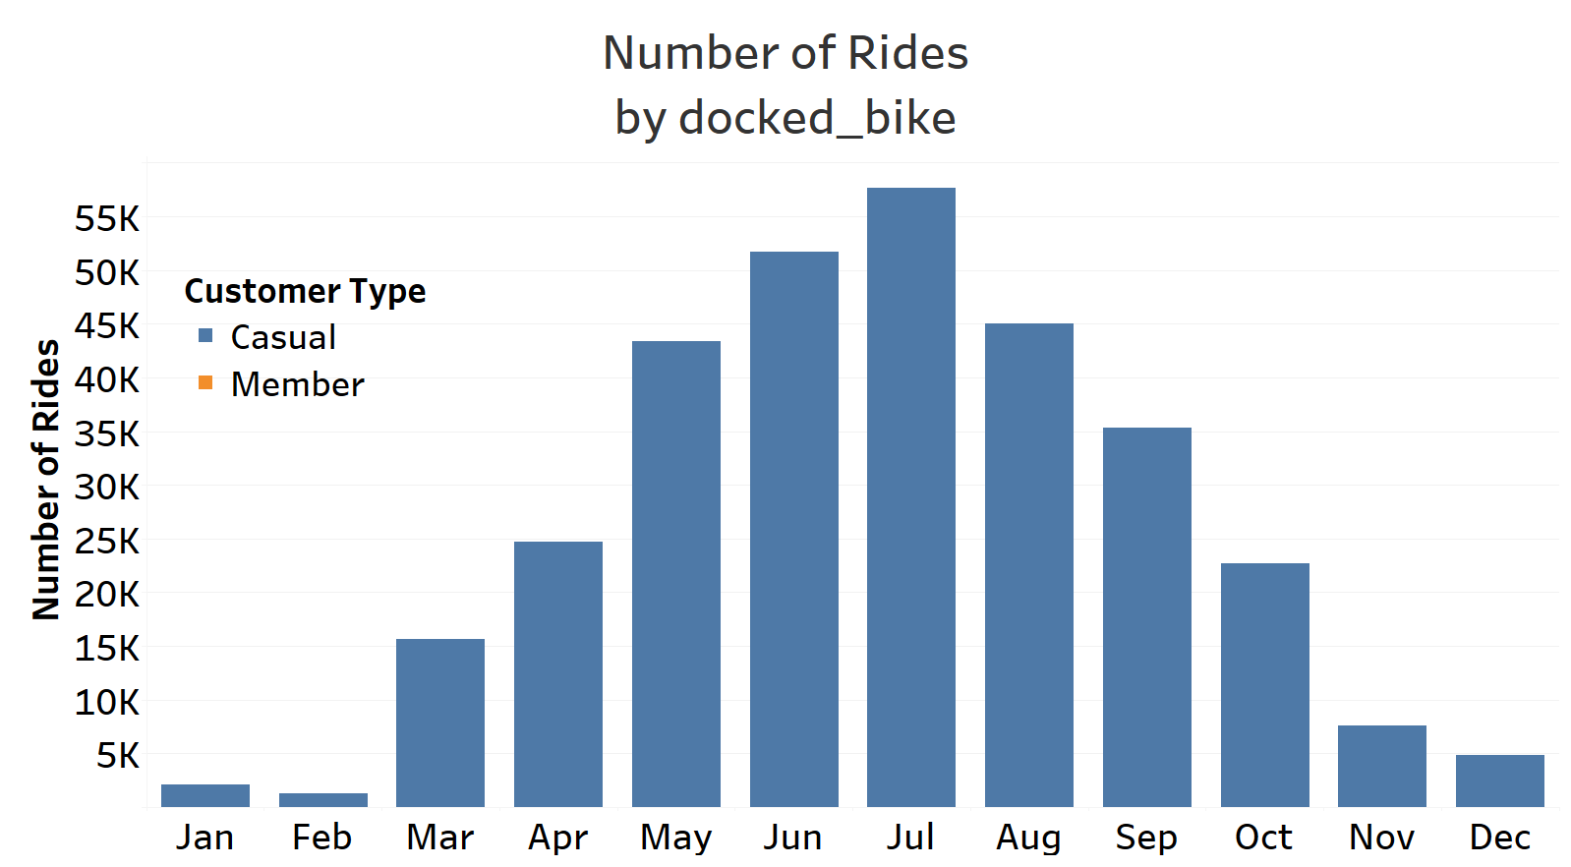
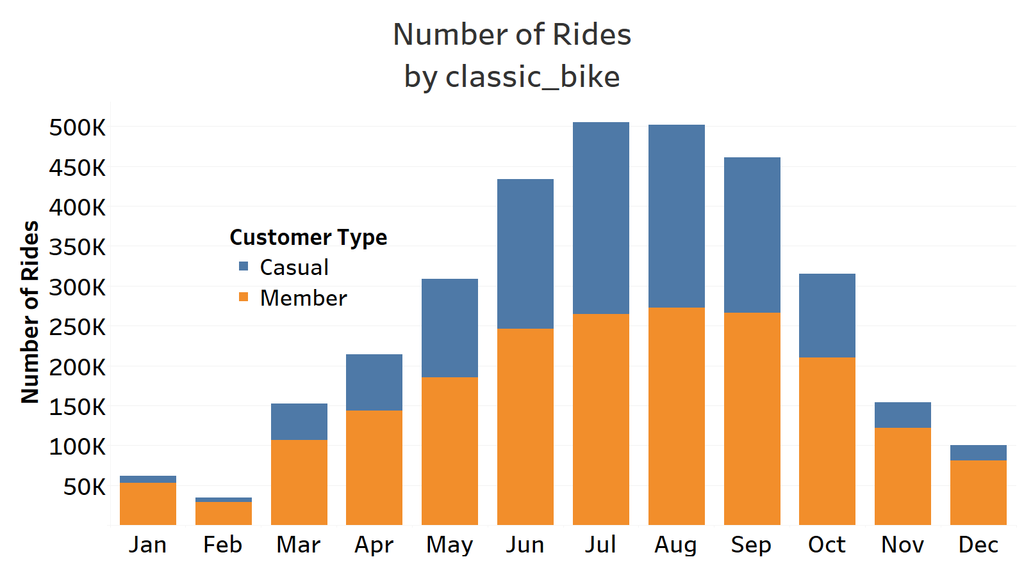
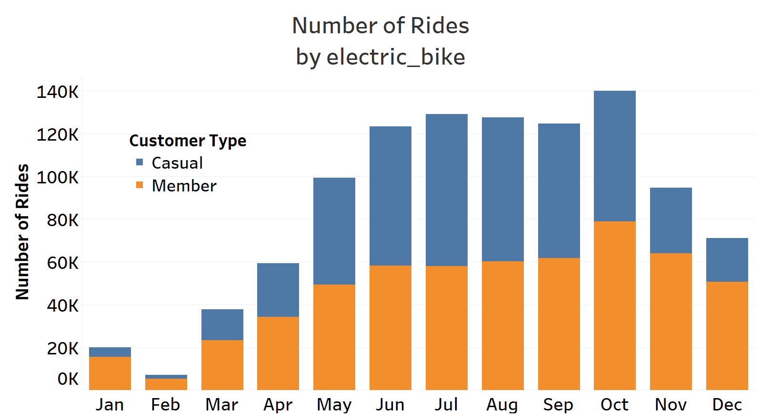
Rideable Type
Casual users patronize all the available rideable types; electric, docked and classic bikes.
However, Members patronize only electric and classic bikes.

Slide 10
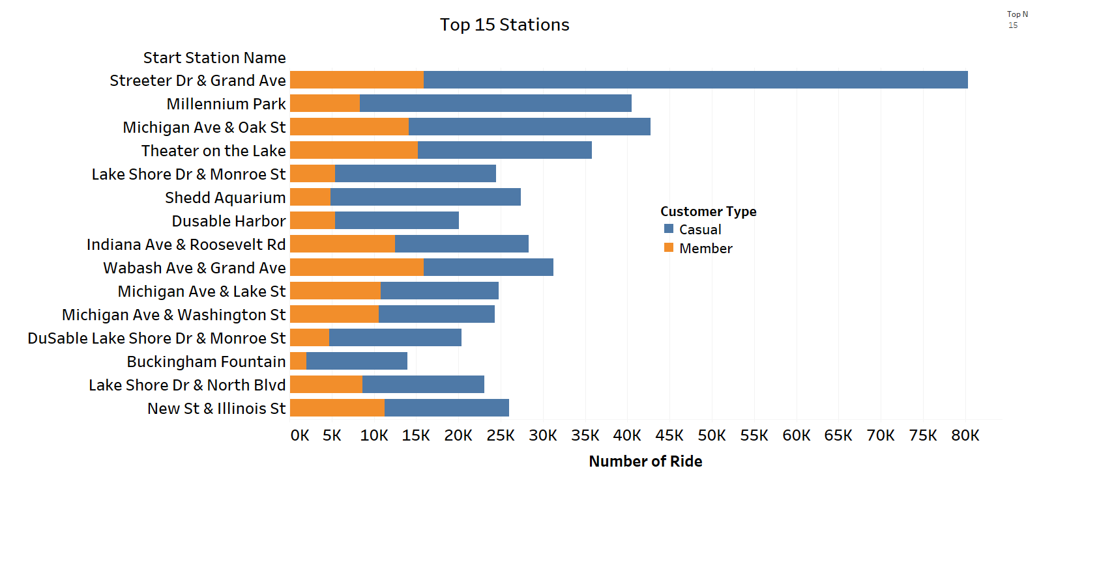
Top 15 Station

Slide 11
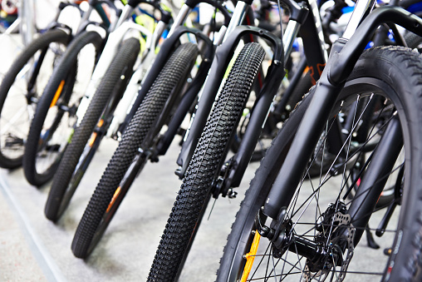
Conclusion
Casual users are known to take about 11% fewer rides, however, spend about twice longer ride duration than Members.
Casual users are mostly active in the months of May to October per the number of rides and trip durations. These months correlate with warmer temperatures.
Casual users are more active during the weekends as they recorded ~ 50% increase in both number of rides and trip durations than on the weekdays.
Casual users are the only ones that patronize docked bikes.
Overall, the behaviors of Casual riders suggest that their use of bikes are mainly for recreation. This is because, most recreational activities happens on the weekends and in warmer months of the year.

Slide 12
Recommendations
Seasonal members packages can be introduced as marketing strategy such as
Weekend membership
Summer membership
Annual membership
Ads prepared should target recreational events at weekends and during the months of May to October. Ads should also target the top stations where Casual users begin their trips.
Special promotion or discount should be introduced to encourage bike users in months or season with colder temperatures.

Slide 13
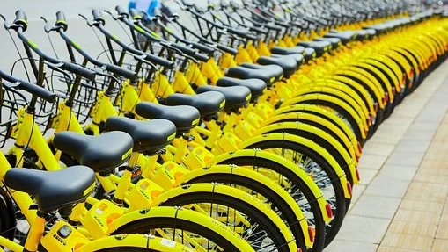
Thank you

